Slide 1
Semi-Automatic Annotation Tool for
Autonomous Driving Scene
Shucheng Zhong, Yifan Dai, Yifan Zhao, Yueying Li, Yuying Li
Mentor: Chong Han, Hanyang Gui
Sponsor: Feilong Liu, HJ Drive Inc
Notes:
VM467 - Introduction to Robotics UM-SJTU Joint Institute, Shanghai Jiao Tong University Copyright 2009. Kai Xu. All Rights Reserved
Hello everyone. We are team 15, and our project is [Title], sponsored by HJ drive. Our team consists of 5 people:

Slide 2


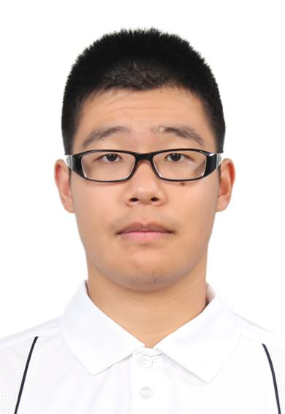
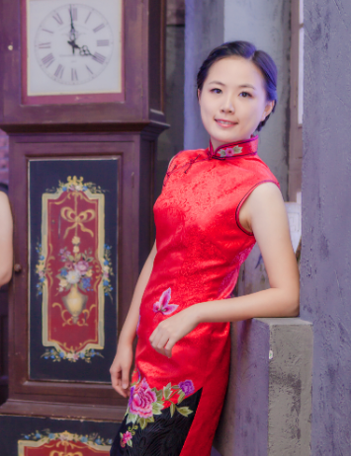
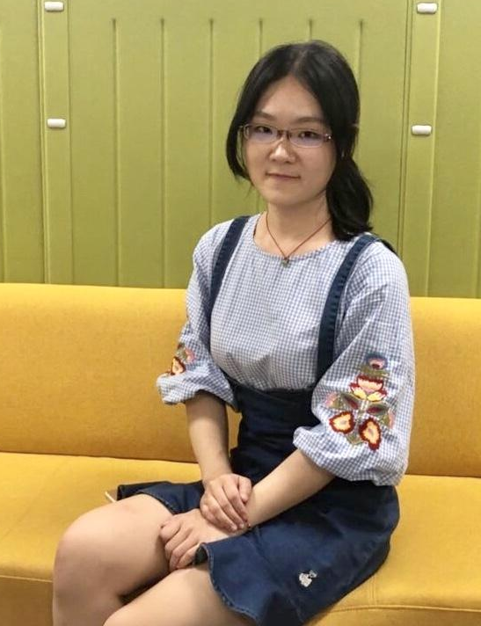
Meet Our Team
Shucheng Zhong
Network
Yifan Zhao
Team Leader
Yifan Dai
UI
Yueying Li
DL
Yuying Li
DL
Notes:
Shucheng Zhong is responsible of network and cloud technology in the project.
Yifan Dai will take care of the user interface of our product.
Yueying Li and Yuying Li are our deep learning specialist;
I’m the project leader Yifan, I’ll also work on the UI of our project apart from coordinating the team.

Slide 3
Design Problem
manual annotation
accuracy
efficiency
semi automatic annotation
fully automatic annotation
Notes:
Our sponsor HJ drive concentrates on the business of autonomous driving. Autonomous driving calls for various deep learning models for computer vision tasks, whose training and evaluation require large, high-quality datasets.
Several approaches exist for the purpose of creating labeled datasets. Manual annotation has the best accuracy due to the prior knowledge of humans, but also the lowest efficiency. A fully automatic annotation process however, gives too much errors which tend to render the output unusable. This project aims to design a semi-automatic tool to have the best of both worlds: efficient image labeling with minimal manual correction.
VM467 - Introduction to Robotics UM-SJTU Joint Institute, Shanghai Jiao Tong University Copyright 2009. Kai Xu. All Rights Reserved
3

Slide 4
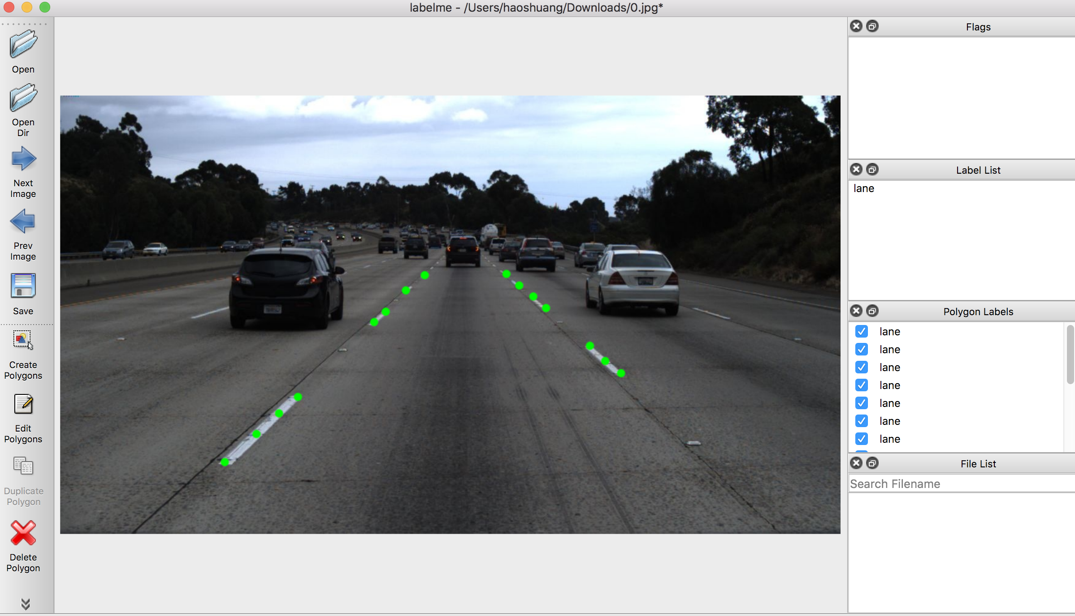
Existing Solutions
Labelme:
An annotation tool inspired by the dataset from MIT CSAIL
Lack tag structure
No sub-tagging
No color differentiation
Lack user-friendliness
No default label suggestions
Notes:
Before diving deep into our project, let us review some of the related products and technologies. The first product that comes across is called labelme. The annotation tool supports several kinds of DNN models and different types of images, and provides good suggestion for annotation on normal images. However, it doesn’t support sub-tagging, provides no color difference for different tags, and doesn’t offer default label suggestions, all causing confusion of users.
VM467 - Introduction to Robotics UM-SJTU Joint Institute, Shanghai Jiao Tong University Copyright 2009. Kai Xu. All Rights Reserved
4

Slide 5
Existing Solutions
Supervisely:
Bounding Box, Polygon, Pixelwise online annotation tool
Limitation:
No localization of human joints, hard to predict pedestrian’s future trajectory
No intermediate layer information
Notes:
The second related product is called Supervisely. It is a cloud-friendly web platform and data labeling tools to transform the images / videos / 3d point cloud into high-quality training data. However, it performs poorly on annotations for human pose. Also, the annotated tool does not support further information about the intermediate layers.
VM467 - Introduction to Robotics UM-SJTU Joint Institute, Shanghai Jiao Tong University Copyright 2009. Kai Xu. All Rights Reserved
5

Slide 6
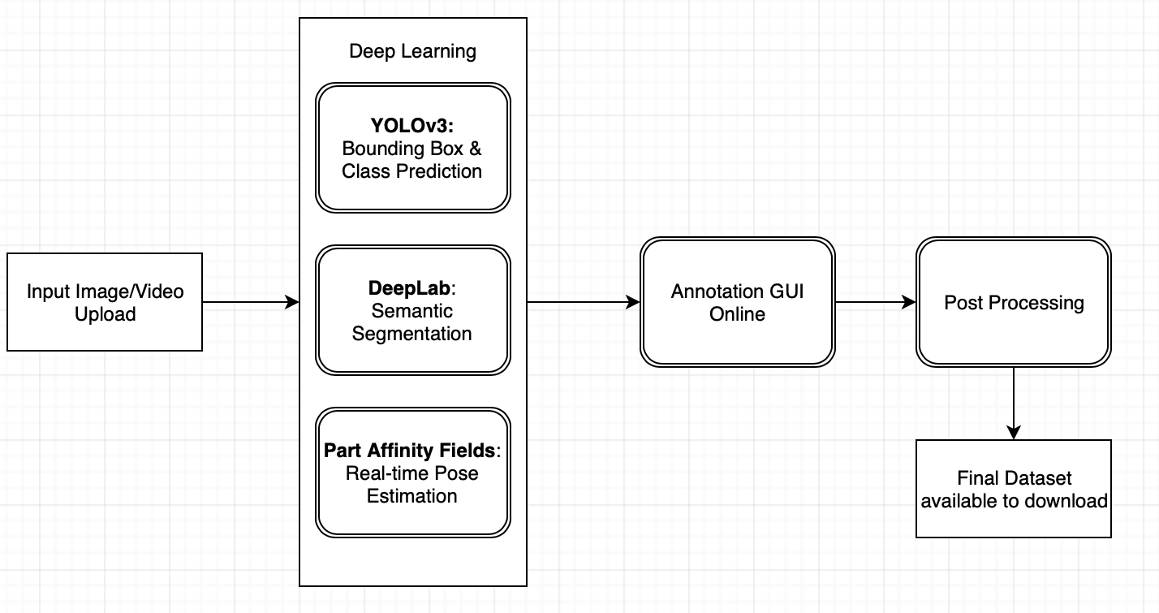
Our Solution
Notes:
The system diagram is shown as follow. The user will first upload their data (like videos of the autonomous driving scene) to be annotated. After that, our platform will deploy some typical deep learning framework to retrieve some useful information for annotation. After some literature review, we decide on using three deep learning framework.
We will show some figures and explain these DNN in detail later.
WIth these information, our GUI will provide the user with suggested labels for pixelwise information, and let them do some manual correction.
VM467 - Introduction to Robotics UM-SJTU Joint Institute, Shanghai Jiao Tong University Copyright 2009. Kai Xu. All Rights Reserved
6

Slide 7
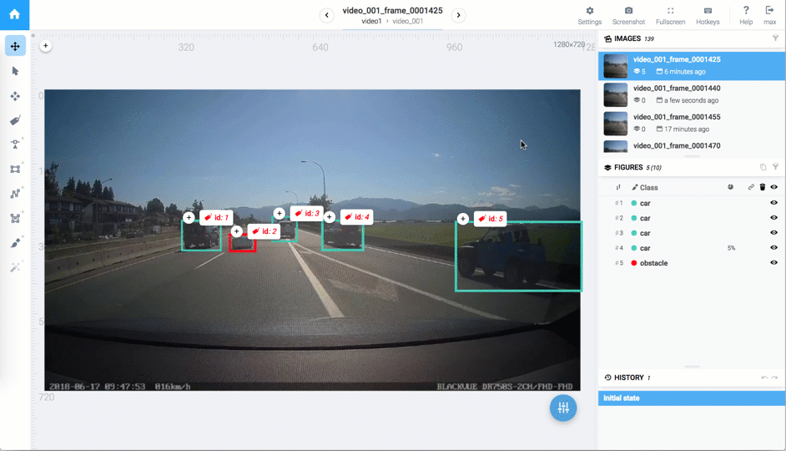
Bounding Box Prediction with YOLOv3
Notes:
We can use YOLOv3 to get the bounding box for class prediction. Bounding boxes are imaginary boxes around objects that are being checked for collision, like pedestrians, vehicles and signs. Five cars are recognized in the graph and car with id2 is classified as an obstacle on the way.
VM467 - Introduction to Robotics UM-SJTU Joint Institute, Shanghai Jiao Tong University Copyright 2009. Kai Xu. All Rights Reserved
7

Slide 8
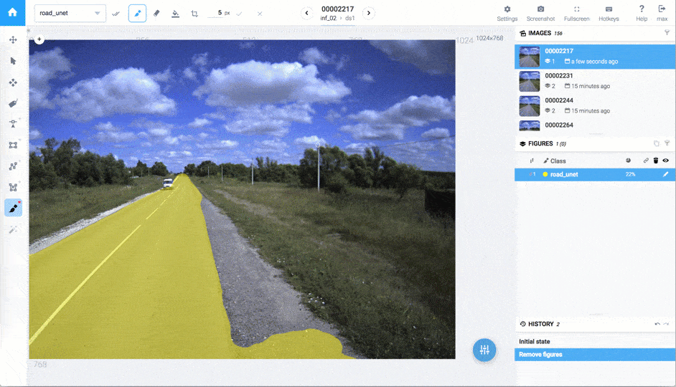
Segmentation with DeepLab
Notes:
DeepLab offers the semantic segmentation result. The road is classified in yellow. Different from image classification used in bounding box, semantic segmentation makes decisions for images in a pixel level. For each pixel, the model needs to classify it as one of the pre-determined classes.
VM467 - Introduction to Robotics UM-SJTU Joint Institute, Shanghai Jiao Tong University Copyright 2009. Kai Xu. All Rights Reserved
8

Slide 9
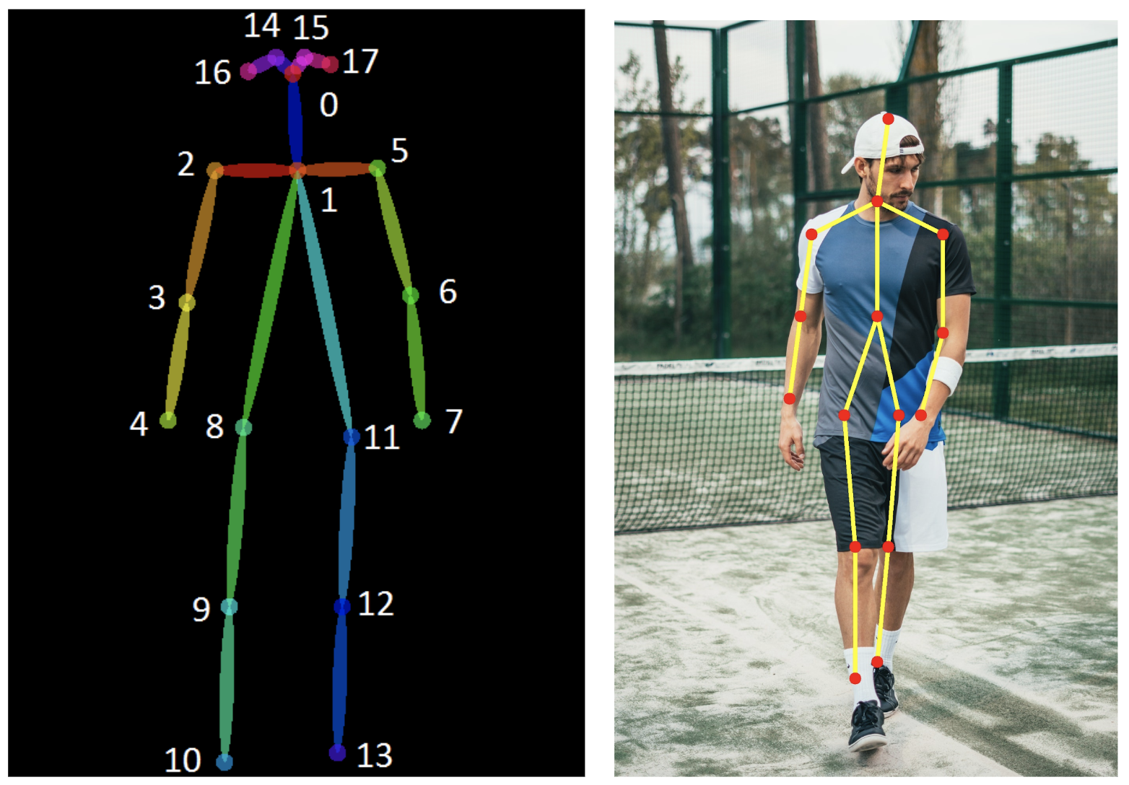
Pose Estimation with PAF
Notes:
With Part Affinity Fields, shorted as PAF, we can localize the real-time pose of a human, including key points in the body parts such as elbows and knees, so that we can understand their behavior and predict future trajectory.
As yueying introduced just now, The collection of these three deep learning results is output for further use in online annotation GUI, shorted for graphical user interface.
+++ Add GUI specs

Slide 10
Quantification
Efficiency: How fast to label the images
Accuracy: Use DNNs to preprocess the input images and give suggestions.
Pixels: Relative percentage of pixels labeled after preprocessing
Size of output Image: Change with the parameters and requirements
Label Hierarchy: Hierarchy depth of labeled objects
Cost: Budget to train DNN and online Deployment

Slide 11
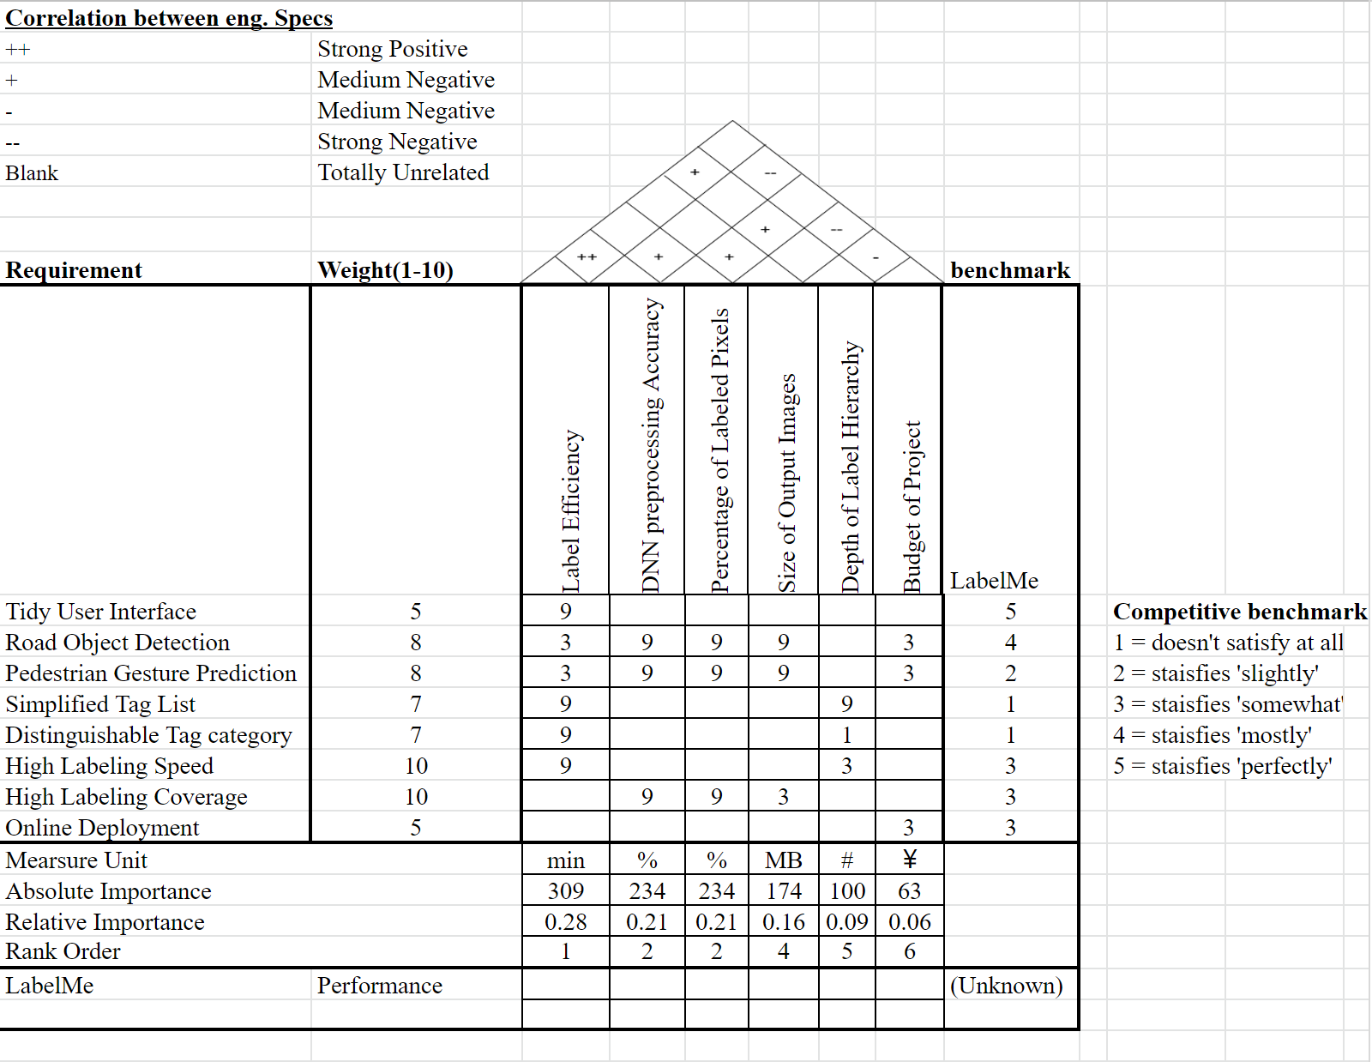
QFD

Slide 12
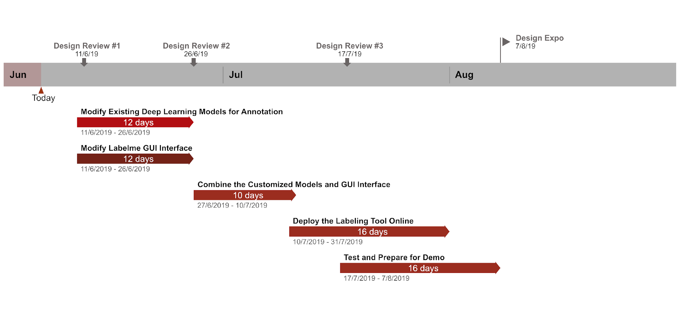
Project Schedule
Notes:
Now I’ll briefly introduce our schedule for the project. We have split our work into several sub-tasks. After Design Review \#1, we will work on the model and GUI modification in parallel. We expect to finish the two parts before Design Review \#2. Then we will combine them together and then work on the online deployment and finish it before August, and in the meantime keep refining our tool and prepare for Demo.
VM467 - Introduction to Robotics UM-SJTU Joint Institute, Shanghai Jiao Tong University Copyright 2009. Kai Xu. All Rights Reserved
12

Slide 13
Conclusion
Purpose: Efficient Annotation
Solution: Semi-Automated Annotation Tool
Literature Research
Quantification
Schedule
Notes:
In conclusion, the purpose of our project is to make an annotation tool, so that dataset can be produced more efficiently to help with the development of autonomous driving. Our solution is to make a semi-automated annotation tool to combine the advantages of manual annotation and fully-automated annotation. We have done literature research on related fields and figured out our quantification criteria. And we have split our work into sub-tasks and made a detailed schedule. Our presentation is over, thank you.

Slide 14
Reference
Supervisely:https://hackernoon.com/%EF%B8%8F-advanced-annotation-tools-in-deep-learning-training-data-for-computer-vision-with-supervisely-847f8699a9cb
LabelMe: A Database and Web-Based Tool for Image Annotation
YOLOv3: An Incremental Improvement
DeepLab: Semantic Image Segmentation with Deep Convolutional Nets, Atrous Covolution, and Fully Connected CRFs
Realtime Multi-Person 2D Pose Estimation using Part Affinity Fields
Notes:
https://pjreddie.com/media/files/papers/YOLOv3.pdf
VM467 - Introduction to Robotics UM-SJTU Joint Institute, Shanghai Jiao Tong University Copyright 2009. Kai Xu. All Rights Reserved
14

